Slide 1

Abstraction and Interfaces in C#
Mr. Krishnaraj

Slide 2

Todays Agenda
1
Abstraction
2
Interfaces
3
Use Cases
4
Assignments
5
Debrief

Slide 3
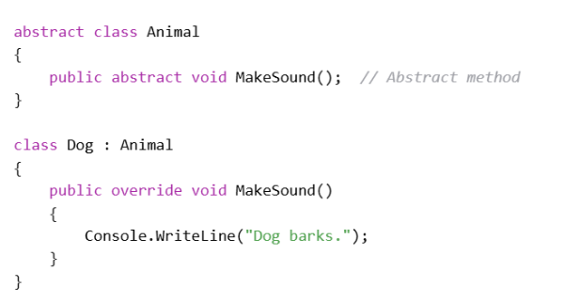

Abstraction
It is the process of hiding the internal implementation details of a class or an object and exposing only the relevant features that are necessary for the outside world.
By using abstraction, developers can reduce complexity and increase efficiency by focusing on essential aspects of an object while hiding unnecessary details. Example,

Slide 4
Abstraction
Abstract classes cannot be instantiated directly.
Derived classes must override all abstract members.
Interfaces provide pure abstraction, with no implementation unless default methods are used (from C# 8.0).
Use abstract classes when you need to provide some default functionality; use interfaces when you need to ensure that different classes follow the same contract.
Polymorphism works well with abstraction to allow flexible object handling.

Slide 5
Interfaces
Interface defines a contract or a blueprint for classes or structs.
It declares a set of methods, properties, events, or indexers without providing any implementation.
Any class or struct that implements the interface must provide concrete implementations for all its members.
Interfaces are used to achieve multiple inheritance-like behavior in C#, promote loose coupling, and establish standardization across unrelated classes.

Slide 6
Interfaces
Why Use Interfaces?
To define a set of common behaviors that multiple classes can share.
To enforce uniform method signatures across unrelated classes.
To achieve multiple inheritance behavior in a controlled and safe way.
To build loosely coupled systems that are easy to extend and maintain.
To support polymorphism, enabling objects of different classes to be treated uniformly based on shared behaviors.

Slide 7
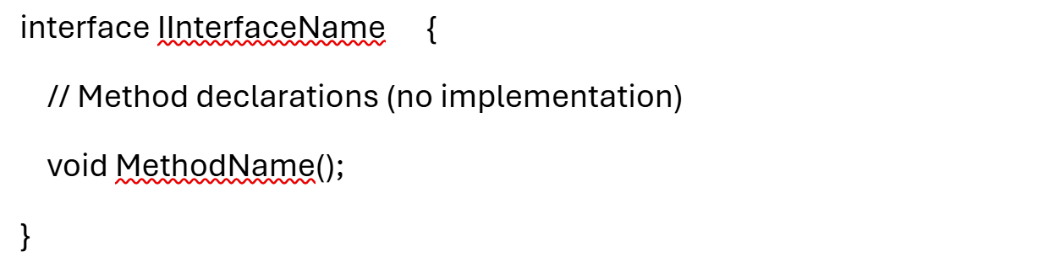
Interfaces
Syntax:
Naming Convention: By convention, interface names start with I (e.g., IDriveable, IAnimal).

Slide 8
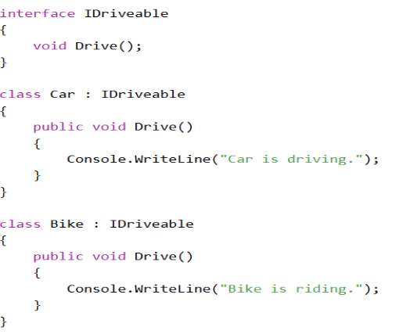
Interfaces
Implementing an Interface :
When a class implements an interface, it must provide implementations for all members defined in that interface.
Example:

Slide 9
Use Cases

Slide 10

Assignment
Sample Motivational Quotes:
"You're doing great!",
"Every step counts!",
"Keep pushing!",
"Believe in yourself!",
"Flutter on!"

Slide 11

+
+
+
+
LEVEL
Stretch Goals
+
UP
+
+

Slide 12
Debrief
Abstraction
Interfaces
Use cases

Slide 13
📘 Official Resources (High-Quality & Up-to-Date)
References

Slide 14

Thank you

